Slide 1
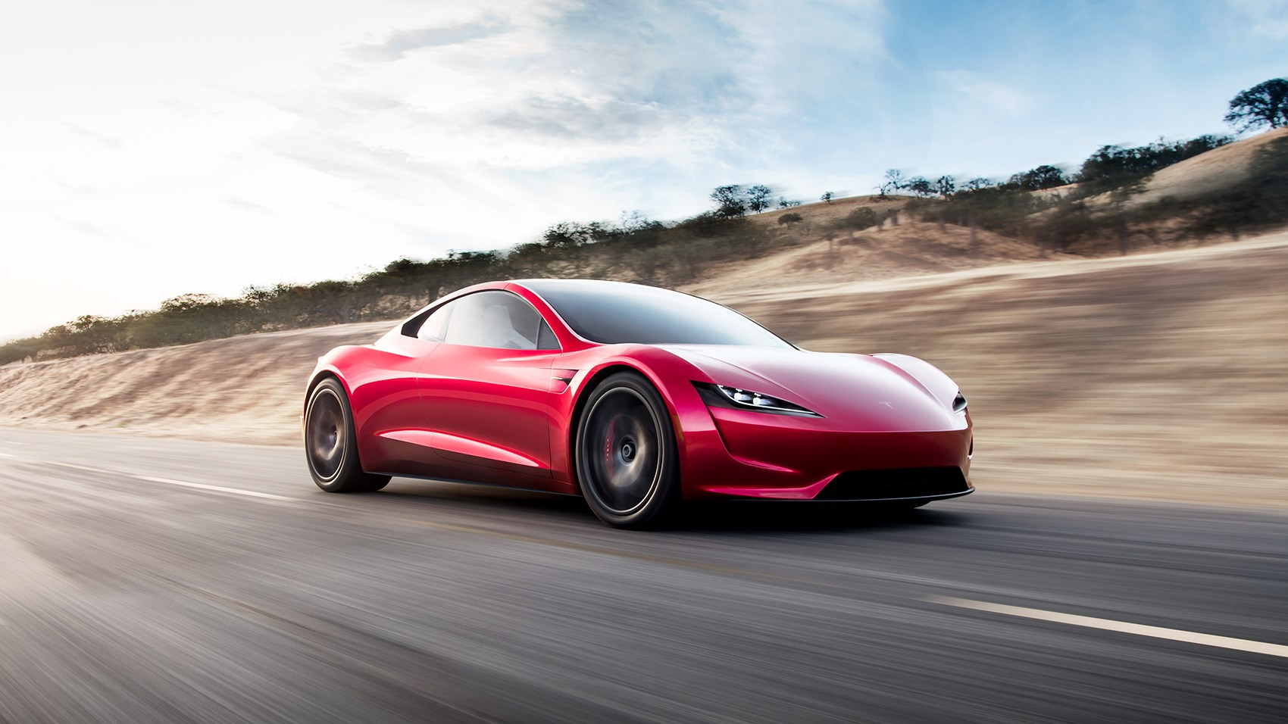
Why is India not ready for Tesla?

Slide 2

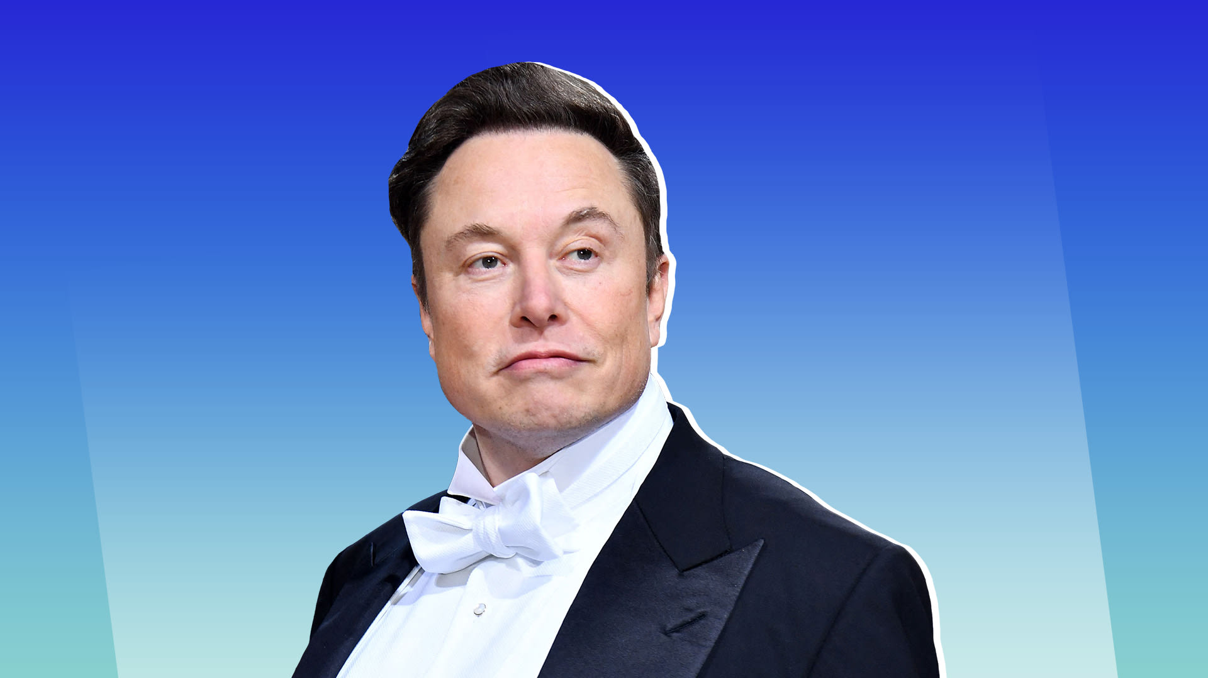
This paragraph is aimed at displaying briefly tesla's history, in order to have an idea of the background of the company.. Tesla Motor has been founded in 2003 in California in the united states of America, by Elon musk a South African entrepreneur who provided capital and assumed the roles of chairman of the board of directors and head of production design. Moreover, it should be noted that the location of company's headquarters is in the silicon valley in California, where are situated the officers of many of the main high-tech companies in the world, was relevant for Tesla in order to innovate creating a proper technology for its electric cars. In fact, that area are present many experts that helped the company to achieve its objectives. For instance, many cars have a wide touch screen on the instrument panel of the vehicle, and in that area many people having the knowledge how to develop this kind of component. The first car that tesla has produced has been Roadster.

Slide 3
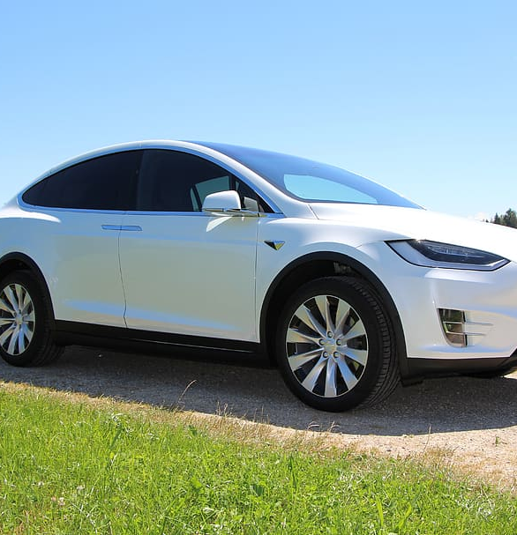
Tesla Motor Elon Musk successfully established Tesla Motors as one of the leaders in the electric vehicle industry since his induction as CEO 2008. Tesla Motors designs, manufacturers and sells electric cars.Autopilot is an advanced driver- assistance system developed by Tesla.Tesla's plan to enter the Indian market has been put on hold due to the high import taxes on electric vehicles. India leives a 60% import tax on electric vehicles price $40,000 or less and a 100% on those priced above $40,000. Tesla car starts at $44,600 (Rs 34 lakh) in the US and selling cars in India with 100% import taxes would mean selling out around ₹ 60 lakh for a car.

Slide 4
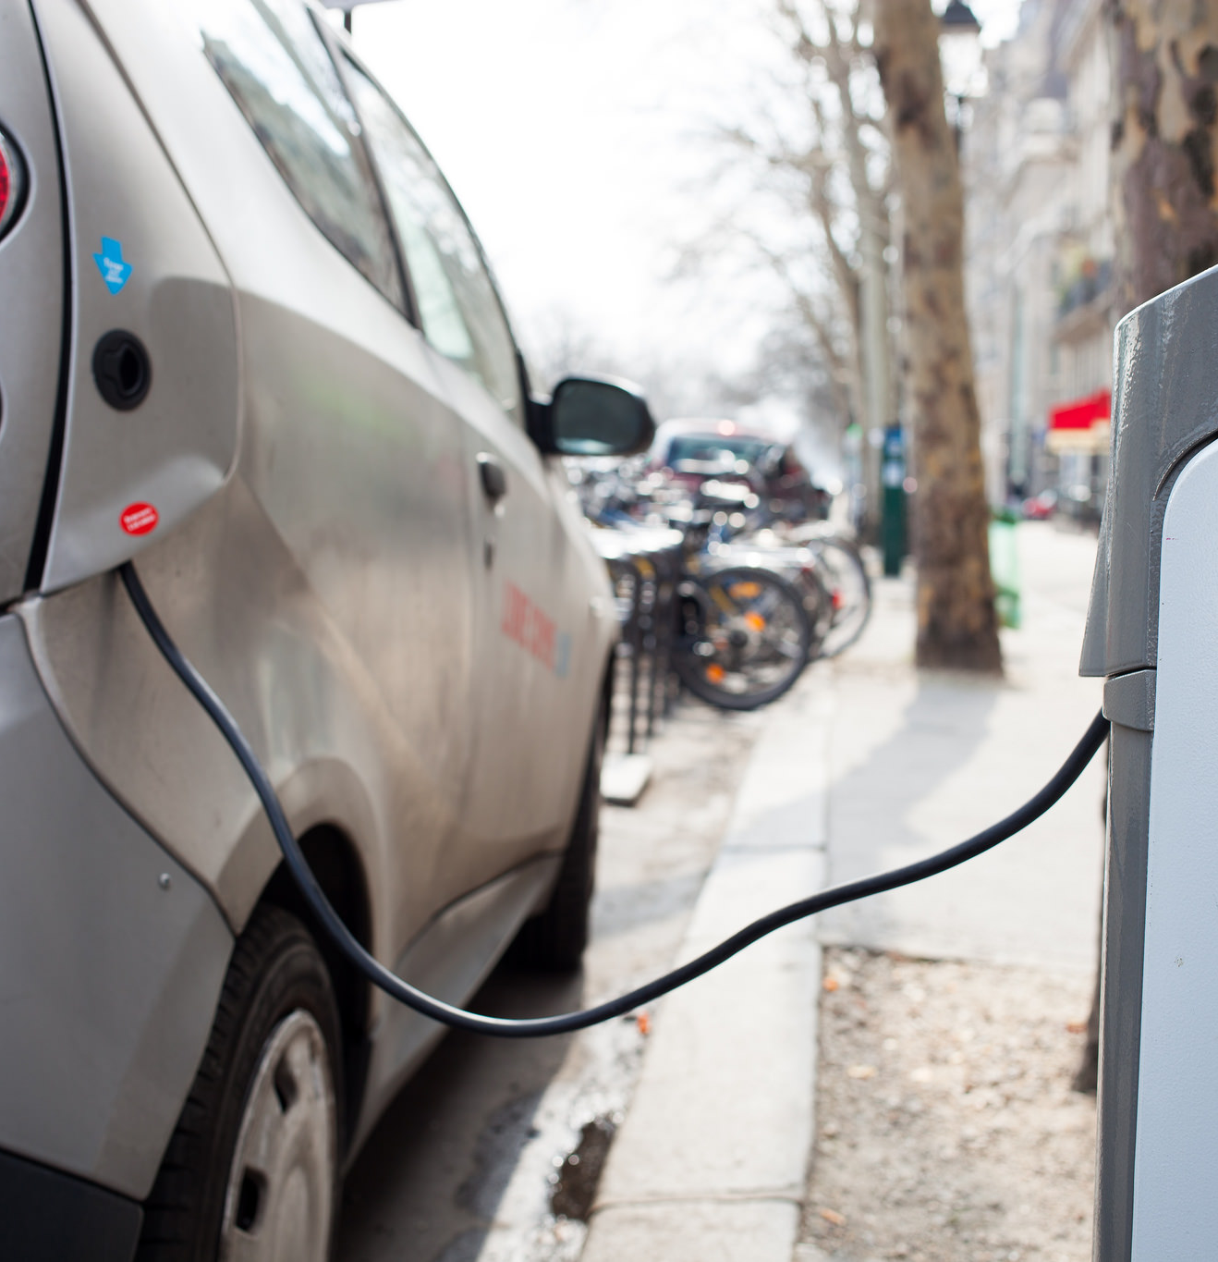
Charging points
One main challenge is the infrastructure. We do not have charging points at parking lots and many other places. India needs to develop widespread charging infrastructure.

Slide 5
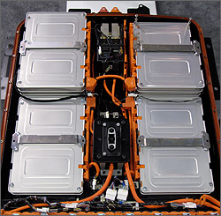
Lithium-ion batteries
India relies on other countries for lithium-ion batteries which is a key component for electric vehicles.

Slide 6
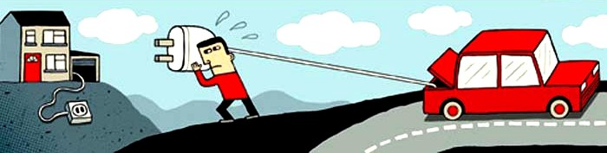
Range anxiety
Another crucial challenge is range anxiety. Buyers are often worried the Electric vehicles can travel long distances

Slide 7
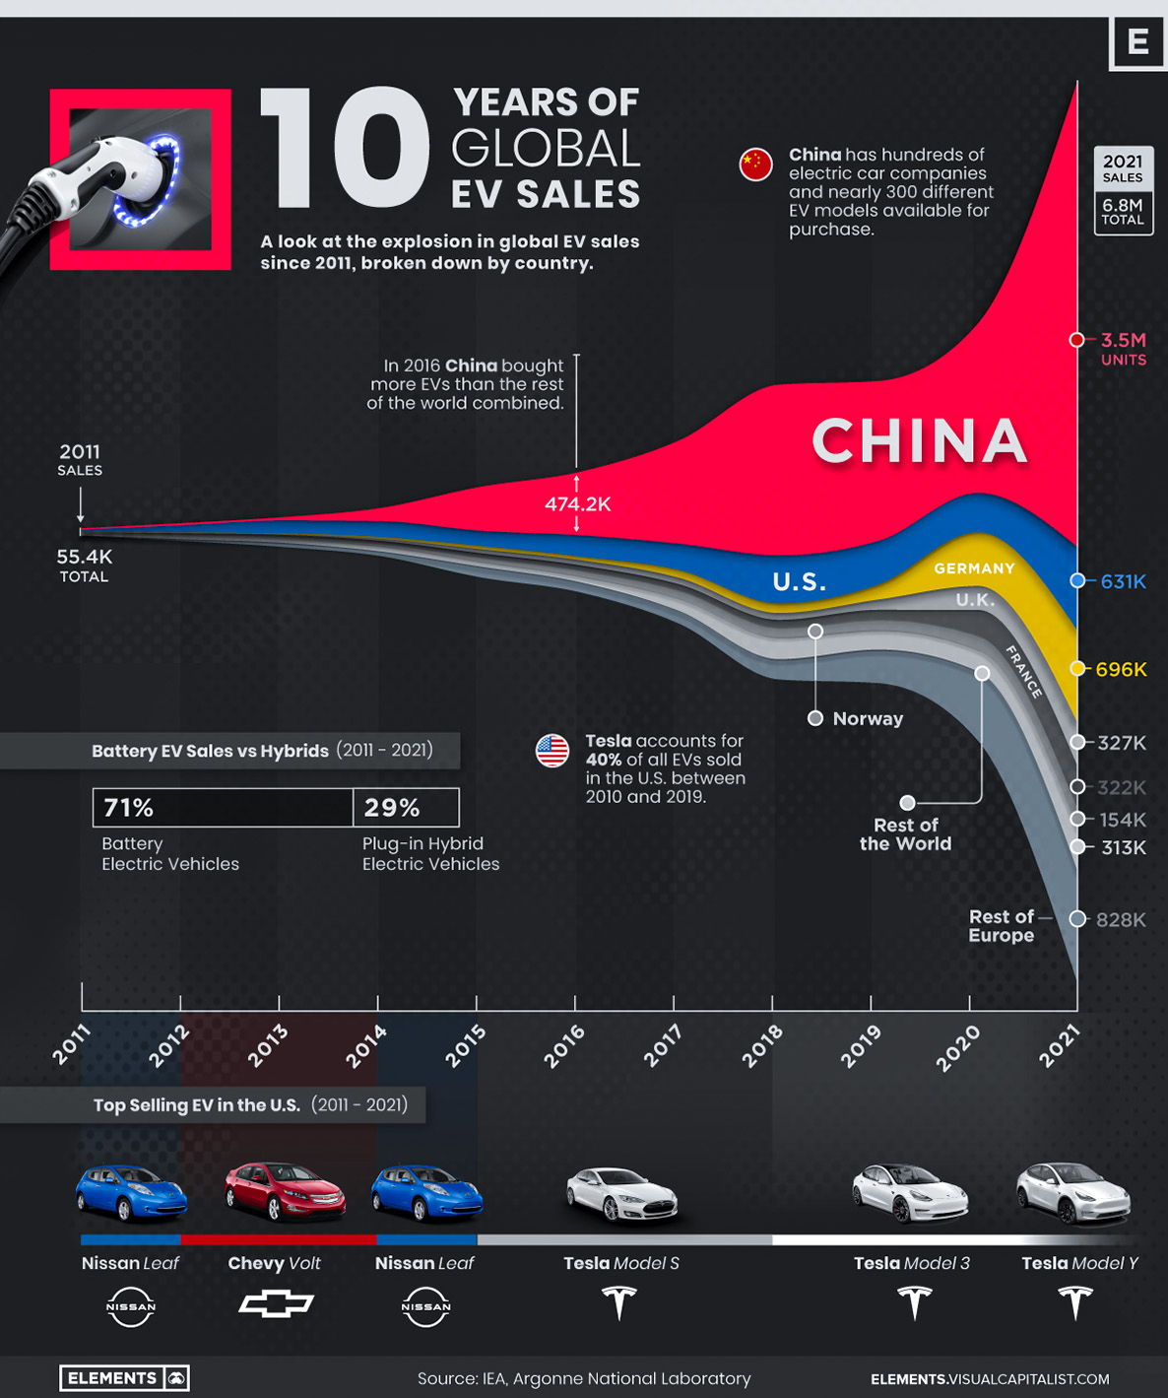

Slide 8

By balavardhan

